Slide 1
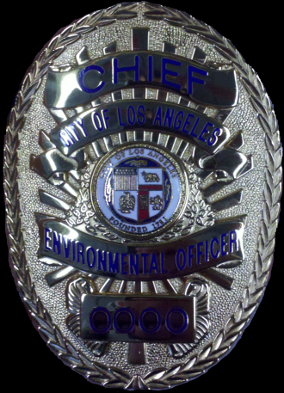

ENVIRONMENTAL OFFICERS
LA SANITATION
WATERSHED PROTECTION
INTRODUCTION TO DUTIES & RESPONSIBILITIES

Slide 2
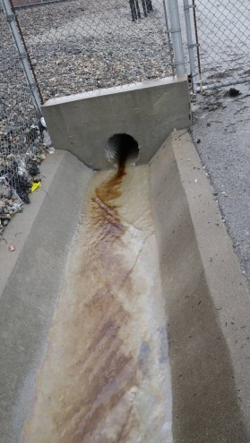
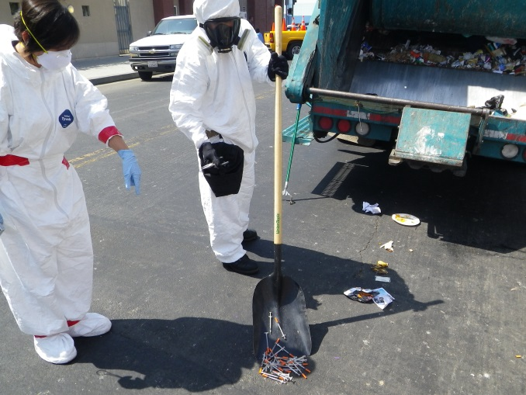
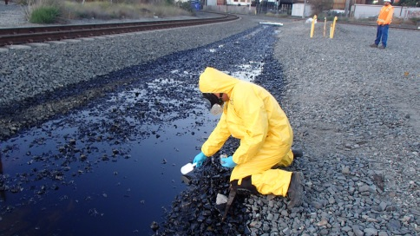
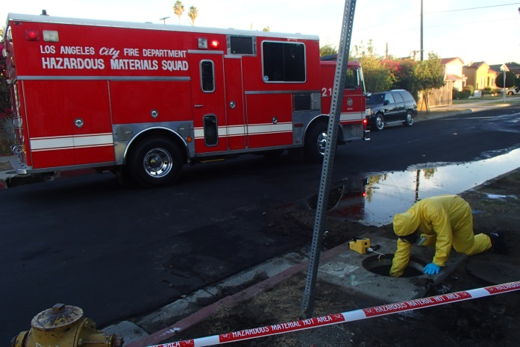
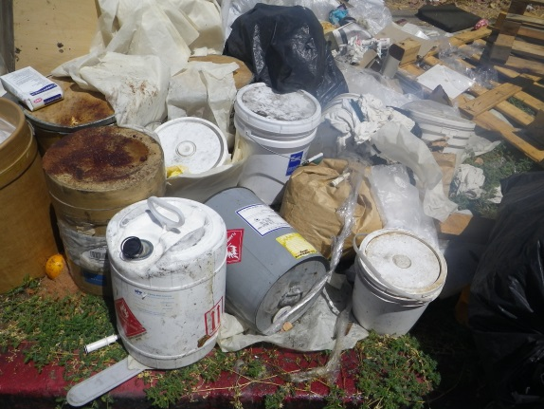
OUTLINE
BACKGROUND
AUTHORITY
FUNCTIONS
TRAINING
PROPOSED STATEWIDE TRAINING

Slide 3

BACKGROUND
The Department of Public Works,
Bureau of Sanitation,
Watershed Protection Division, Environmental Enforcement and Emergency Response Unit (BOS WPD EEE)
    is responsible for the enforcement of applicable provisions of law related to the control of discharges and the contribution of pollutants that could potentially affect the storm drain system, the environment, and public health and safety.

Slide 4
BACKGROUND Who we are?
Environmental Compliance Inspectors with peace officer arrest authority and org. chart,
  Authorized Positions
    1 Chief II
    2 Assistant Chief
    4 Lieutenants
    29 Environmental Officers (ECI’s)

Slide 5
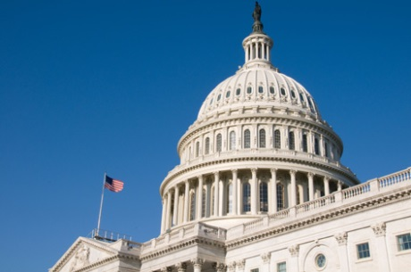
BACKGROUND
Why?
  In 1987, U.S. Congress amended the Clean Water Act to require the Environmental Protection Agency (EPA) to establish requirements for stormwater discharges.
  Pursuant to the Clean Water Act Section 402 (p)(3)(B), municipal NPDES permits were given either on a system or jurisdiction-wide basis.

Slide 6

FEDERAL MANDATE
  Code of Federal Regulations (CFR)
    Requirement under the EPA,
    Pursuant to CFR Title 40 section 122.26 (d) (2) (i) (B) (C), state that the municipalities are required to prohibit (by way of ordinance, order, or similar means) illicit discharges into the storm drain system which includes the public right-of-way.
    ADD ENF REQUIREMENT SECTION
    Also states anything “that could potentially affect the storm drain system, environment & public health.”

Slide 7

AUTHORITY
In 2014, the City of Los Angeles passed ordinance 183229, providing enhanced peace officer arrest authority (P.C. 830.7(j)) for WPD Environmental Officers.

Slide 8
AUTHORITY
Memorandum of Agreement with LAPD
  LAPD Chief Becks sign MOA on April 17, 2015
    Authorizes WPD as Law Enforcement Agency for environmental crimes.
    Designates how LAPD supports WPD to perform investigations of criminal violations: infractions, misdemeanors and felonies.

Slide 9

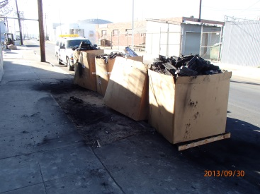
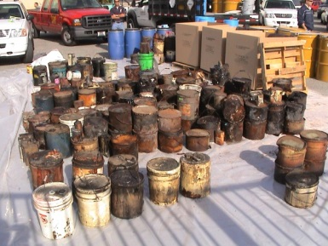
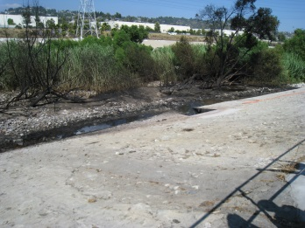
FUNCTIONS
ENVIRONMENTAL CRIMES INVESTIGATIONS (MOA with LAPD)
  Illegal dumping of pollutants, hazardous materials/waste/substances
  Illicit discharges/connections
  LAMC 56.11 – personal property in public areas (new)
  Littering

Slide 10
FUNCTIONS
EMERGENCY RESPONSE (LAFD/LAPD JHAT)
  CA cert. HAZMAT technicians/specialists
  Hazard Categorizations (HazCat)
  Authorized to contract hazmat clean up companies.
  Authorized DOT signer for hazwaste manifests.
  HOW CLEAN IS CLEAN?

Slide 11
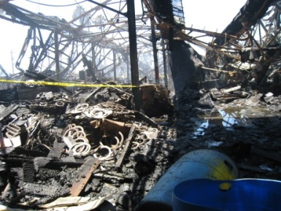
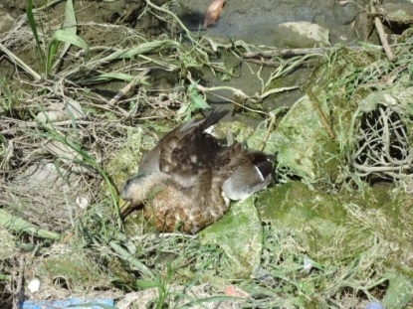
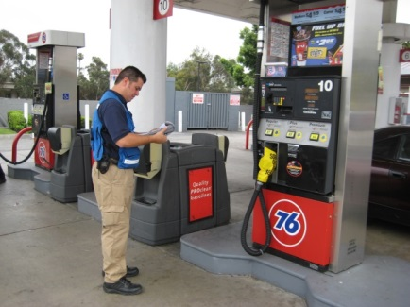
FUNCTIONS
DIRECTED ENFORCEMENT ACTIVITIES
  INSPECTIONS TO COMPLY WITH LOCAL/STATE/FEDERAL CLEAN WATER ACT STANDARDS

Slide 12
FUNCTIONS
  SURVEILLANCE
    BUSINESSES: IC/ID, BMPs, etc.
    ROW: illegal dumping of solid waste, hazwaste (surveillance cameras)

Slide 13
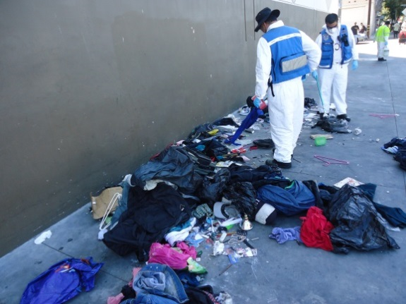
FUNCTIONS (NEW)
Scavenging Enforcement (proposed)
Proactive policing (proposed)
Bins out (proposed)

Slide 14
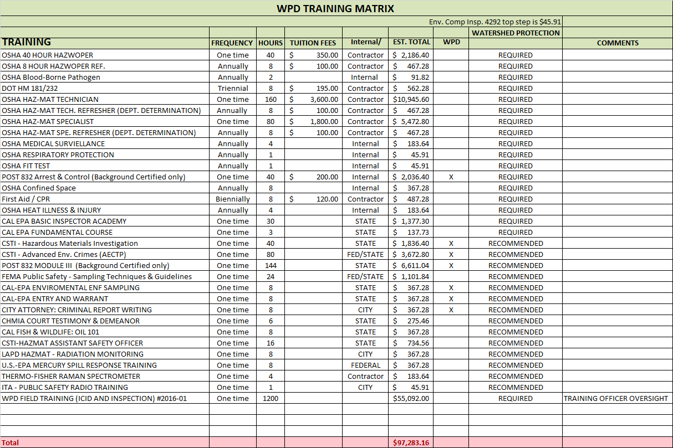
TRAINING

Slide 15
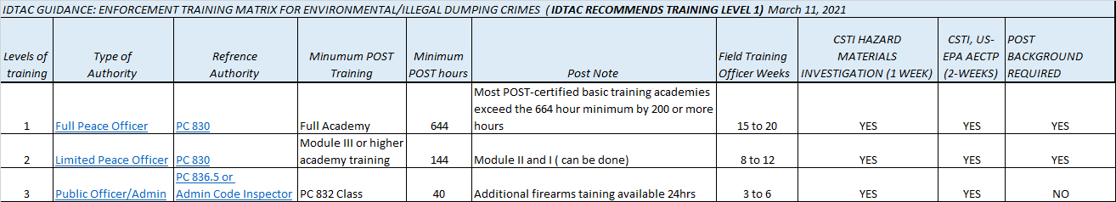
TRAINING STATE GUIDANCE (Draft)

Slide 16
ENFORCEMENT SUMMARY
CITATIONS
  2019
  2020
CRIMINAL REFERRALS
  2019
  2020
Notice of Violations
  Notice to Comply
  Written warning
LA City has Administrative Authority as well

Slide 17
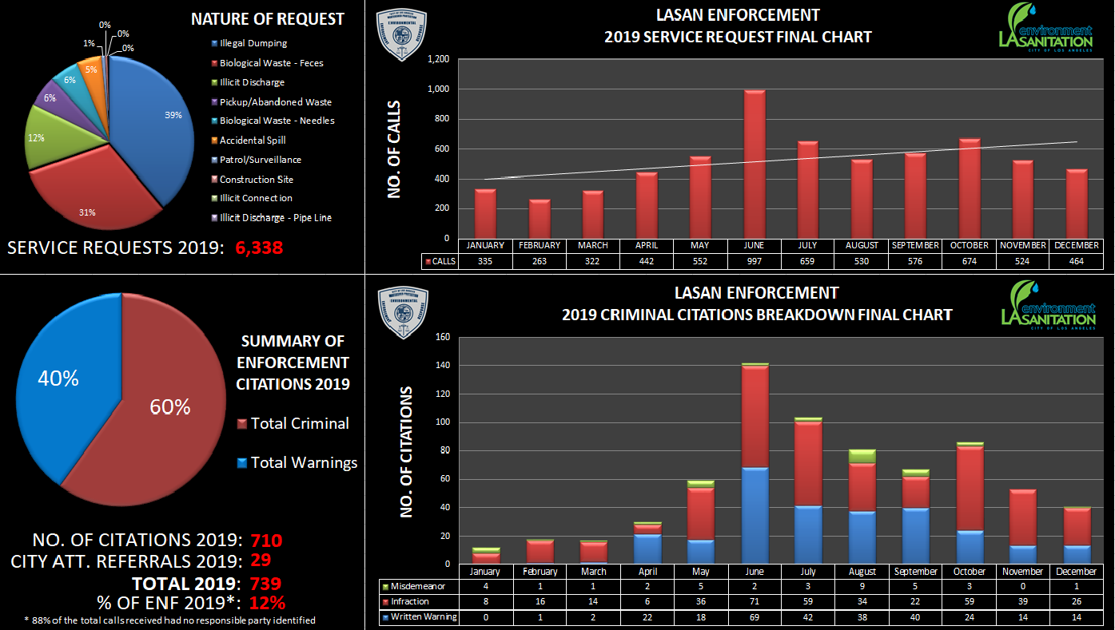
CITATIONS 2019

Slide 18
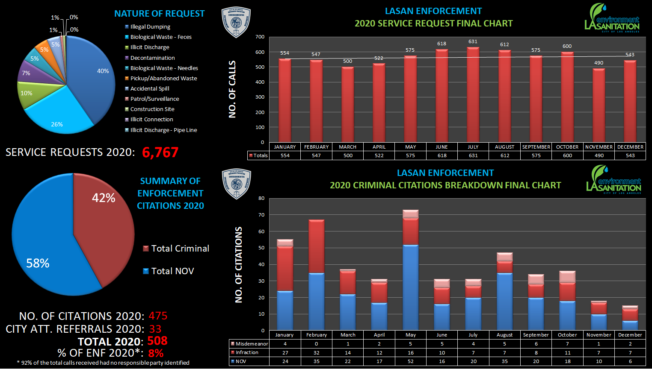
CITATIONS 2020

Slide 19
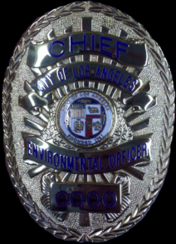
THANKS
Gonzalo Barriga Asst. Ch.
  EMAIL: gonzalo.barriga@lacity.org

