Slide 1



Older Adult Mental Health & Wellness
Sponsored by the Office of Supervisor Keith Carson (District 5)
Presenters:
Kate Jones, RN,MS, MSN
Director of Adult and Older Adult Services, Alameda County Behavioral Health
Lynn Trinh O’Leary, Psy.D
Director of Program Operations, Felton Institute
April 29,2021
Alameda County
Behavioral Health Care Services
MENTAL HEALTH & SUBSTANCE USE SERVICES

Slide 2
Community Mental Health Webinar series
GOALS:
  How and where to access services for older adults
  Understand the concerns of older adults and their loved ones
  How to address older adult mental wellness

Slide 3
Alameda County Behavioral Health (ACBH)
Who We Serve
Alameda County Behavioral Health Adult and Older Adult System of Care serves adults 18 and above whose serious mental illness is moderate-to-severe and/or whose substance use seriously impacts his/her/their day-to-day activities of daily living
Individuals who are Medi-Cal recipients, Medi-Cal eligible, Medi-Cal/Medicare recipients (Medi-Medi), HealthPAC recipients

Slide 4
How Do I/My Loved One Get Services?
Common entry points into our system
  Emergency Departments
  Crisis Stabilization Units
  Referrals from Family/Self through our ACCESS line (eligibility, screening, and referrals for specialty mental health services in Alameda County)
  Other programs or services in the community
  For those that do not qualify for specialty mental health services:
    Alameda Alliance
    Anthem Blue Cross
    Kaiser
    Contact your private/commercial insurer customer service

Slide 5
ACBH Mental Health Services
Older Adult Specific Services:
Geriatric Assessment Response Team (GART)- assessment & referral
Older Adult Service Team (Felton Institute)- case management
Circa 60 Full-Service Partnership (BACS)- intensive case management
Morton Baker Center Mental Health Rehabilitation Center
General Mental Health Services:
Assessment, Therapy, Psychiatric medication support, management, and consultation; Urgent medication support
Case Management/Intensive Case Management for care coordination and support
Inpatient hospitalization
Housing support services like supported residential living; Employment; Outreach and Engagement
Community Integration Services for persons transitioning from the criminal justice system
Prevention and Early Intervention Services for Underserved English Limited Proficiency Services
Other Services

Slide 6

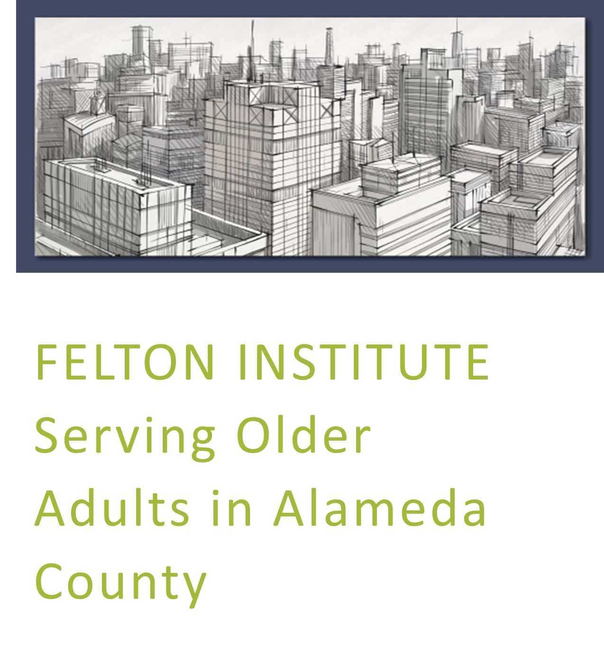

Slide 7
Challenges and Issues Older Adults Face
Mental Health & Behavioral Challenges
Psychiatry and Gero-psychiatry
Conservatorship
Housing
Health/Medical Care
Lack of Social Support
Transportation
Food and Nutrition
Aging-specific Resources and Supplies
Financial Assistance
Specialized Risk Assessment and Management
Substance Abuse/Dependence
Societal attitudes towards aging adults in the US dominant culture
Socio-cultural
Notes:
Mental Health & Behavioral Challenges (depression, isolation)
Psychiatry and Gero-psychiatry (i.e. mental health v dementia)
Conservatorship (loss of independent decision making and control)
Housing (lack of safe affordable housing)
Medical Care (chronic health conditions and lack of provider expertise)
Lack of Social Support (loss of loved ones and friends, lack of family support)
Transportation (loss of driving privileges, navigating public transport)
Food and Nutrition (expense of food, dehydration, decreased cooking)
Aging-specific Resources and Supplies
Financial Assistance (limited income, need assistance to pay bills, risk of fiscal abuse)
Specialized Risk Assessment and Management (fall risk/safety, cognitive)
Substance Abuse/Dependence (common)
Societal attitudes towards aging adults in the US dominant culture
Discuss Socio-cultural factors from large slide here

Slide 8
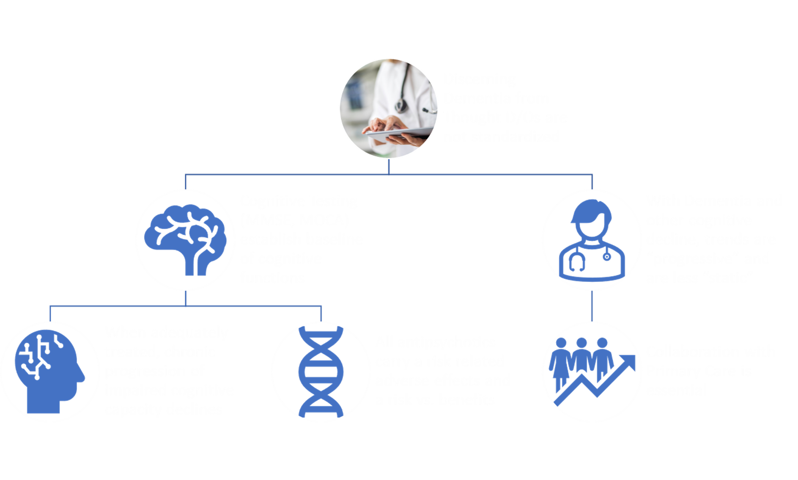

How to figure out what’s happening with me/my loved one/friend: is it mental illness, dementia, a physical issue?
Notes:
Differential Diagnosis

Slide 9
STRATEGIES TO SUPPORT OLDER ADULTS
Provide Case Management:
  Navigate medical network providers
  Linkage and access to medical providers
  Identify age-appropriate resources and supplies
  Advocacy for housing, legal, medical, food, and financial needs
Assist Older Adults in Community Integration:
  Build relationships with providers
  Support to bridge Digital Divide
  Telehealth services
  Education and support in using technology
  Find social programs
Notes:
. Provide Case Management:
Navigate medical network providers (MediCal/MediCare; Kaiser; Blue Cross; etc.)
Linkage and access to medical providers, COVID vaccinations, hearing and vision support
Identify age-appropriate resources and supplies (walkers, wheel-chairs, incontinent undergarments)
Advocacy for housing, legal, medical, and financial needs
2. Assist Older Adults in Community Integration:
Building relationships with providers: Meals on Wheels, Mercy Brown Bag, In Home Supportive Services, Alameda County SubPayee, Adult Protective Services, Center for Elders Independence, Alameda County Care Alliance, Legal Assistance for Seniors, Housing and Economics Rights Association, Life Elder Care, LifeLong Over 60 Clinic, Licensed Board and Cares, Independent Assisted Living Homes
Support to bridge Digital Divide:
Telehealth services
Education and support in using technology

Slide 10
STRATEGIES TO SUPPORT OLDER ADULTS
Psychiatry:
  Get a medication assessment
  Education
  Mental Health Resources
  Communicating with family members and care providers:
  Consistent communication
  Creating a support network
  Create a system to track appointments and changes
  Release of Information
End of Life Planning:
  Discussions of end-of-life planning
  Alameda County Care Alliance
Notes:
. Psychiatry:
Provide medication assessment to establish mental health issues and cognitive functioning
Psychoeducation around medication support, physical ailments, and mental health issues
Collateral services with family members and care providers:
Consistent communication
6. End of Life Planning:
Discussions of end of life planning (Burial Plot or cremation)
Alameda County Care Alliance (agency who provides end of life planning for clients)

Slide 11
STRATEGIES TO SUPPORT FAMILY MEMBERS AND CARE GIVERS
Collateral services with family members and care providers:
  Education around Fall Risk Preventions
  Education around safety in home/residence
  Support to connect with social workers to provide comprehensive support
  How to manage depression and isolation
Psychoeducation around medication management:
  How to manage/administer medications at home
  Options for medication administration
  Tracking med changes and interactions
PROVIDE OPPORTUNITIES FOR CHOICE
Notes:
Collateral services with family members and care providers:
GIVE THEM A CHOICE
Education around Fall Risk Preventions
Education around safety in home/residence (furniture, bathrooms, bedrooms)
Telehealth services
Support to connect with social workers to provide comprehensive support
Psychoeducation around medication management:
How to manage depression and isolation
How to manage/administer medications at home

Slide 12
Older Adult- Specific Resources
  Geriatric Assessment Response Team (GART) 409 Jackson St, Hayward, CA 94544 (510) 383-5020
  Adult Protective Services: Toll-free Elder Abuse Hotline (866-CALL-APS)
  In Home Supportive Services: 6955 Foothill Blvd #300, Oakland, CA 94605 (510) 577-1900
  Life Long Over 60 Clinic: 3260 Sacramento St, Berkeley, CA 94702 510) 981-4100
  Center for Elders Independence (CEI):
    Senior Center in Oakland, California · 510 17th Street, Oakland, CA, CA 94612 · (844) 319-1150
    San Leandro PACE Center 1850 Fairway Dr, San Leandro, CA 94577 (510) 433-1150
    Berkeley PACE Center 1497 Alcatraz Ave, Berkeley, CA 94702 ((510) 433-1150

Slide 13
Older Adult- Specific Resources
  Institute on Aging: 6955 Foothill Blvd #100, Oakland, CA 94605 (510) 577-1900
  Support groups for care givers: (ALZConnected® (alzconnected.org), Caregiver Nation)
  Alzheimer’s Association: 24/7 Helpline: 800.272.3900
  Alameda County Care Alliance: 8501 International Blvd, Oakland, CA 94621 (510) 544-8910
  Mercy Brown Bag: 3431 Foothill Blvd, Oakland, CA 94601 (510) 534-8540
  Meals on Wheels:
    1721 Broadway, Oakland, CA 94612 (510) 777-9560
    2235 Polvorosa Ave #260, San Leandro, CA 94577 (510) 582-1263
  Life Elder Care: 39055 Hastings St, Fremont, CA 94538 (510) 894-0370
  Legal Assistance for Seniors (LAS): 333 Hegenberger Rd Suite 850, Oakland, CA 94621 (510) 832-3040
  Housing and Economics Rights Association (HERA): (510) 271-8443

Slide 14
General Resources
    ACBH ACCESS PROGRAM
    Acute Crisis Care and Evaluation for Systemwide Services
    1-800-491-9099
  Crisis Support Services of Alameda County (24-hr crisis line) (800) 309-2131
Mild-to-Moderate Mental Health:
  Alameda Alliance/Beacon: 855-856-0577
  Kaiser: 510-752-1075
  Anthem Blue Cross: 888-831-2246
  Your Health Care provider customer service line

Slide 15

Alameda County
Behavioral Health Care Services
MENTAL HEALTH & SUBSTANCE USE SERVICES

