Slide 1

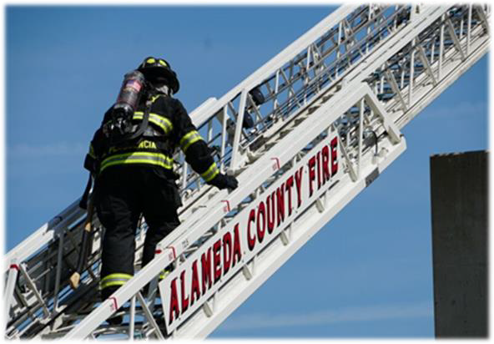
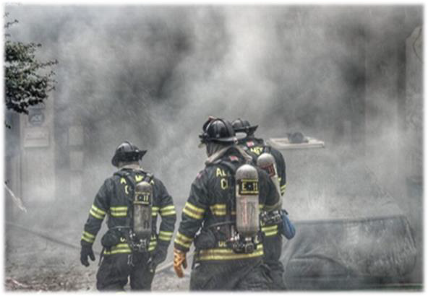
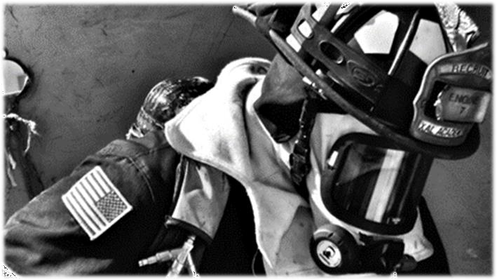
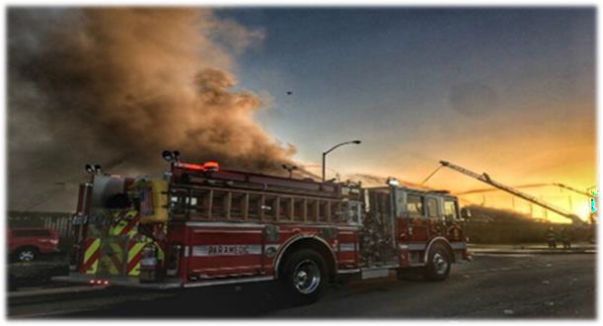
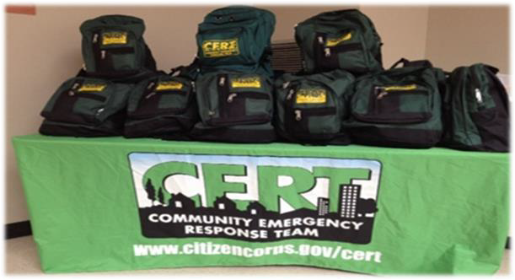
ALAMEDA COUNTY FIRE DEPARTMENT
Information About Measure X
SERVING:
City of Dublin City of Emeryville City of Newark
City of San Leandro City of Union City
Lawrence Berkeley National Laboratory
Lawrence Livermore National Laboratory
Unincorporated Areas of Alameda County
Alameda County Regional Emergency Communications Center “Accredited Center
of Excellence”
1

Slide 2
About the Alameda County Fire Department
ACFD is a dependent fire district formed under the Fire Protection District Law of 1987 and governed by the County Board of Supervisors as the Fire District’s Board of Directors.
The ACFD provides fire protection services to unincorporated County communities, including Ashland, Castro Valley, Cherryland, Livermore, San Lorenzo and Sunol.
The fire stations that would be replace/repaired with Measure X bond funds are at least 30 years old, including two that are over 50 years old and two built over 70 years ago.
– These stations require significant rehabilitation and/or replacement efforts in order to maintain adequate medical,
fire, and disaster emergency response.
2

Slide 3
Measure X Planning
Measure X was developed following extensive community input.
Over 1,000 community residents provided input. Community priorities identified by respondents included:
Reducing emergency response times
Providing emergency life-saving medical devices
Improving emergency communications systems
Enhancing wildfire protection & disaster response services

Slide 4
Ballot Measure
Alameda County Fire Department Fire Safety Bond. Shall the measure authorizing the Alameda County Fire Department to issue $90,000,000 in general obligation bonds to repair / replace outdated stations, thereby maintaining services in unincorporated communities (including medical emergency lifesaving services, fast 911 response, wildfire protection and disaster response) in an estimated levy of 1.6 cents per $100 assessed value, raising on average $5,200,000 annually for approximately 31 years, with oversight and audits, and no funds for salaries, benefits or pensions be adopted?

Slide 5
Why was Measure X placed on the ballot?
Residents of unincorporated communities rely on the medical emergency lifesaving services, fast 911 response, wildfire protection and disaster response services provided by Alameda County firefighters in local stations.
Inadequate funding has forced the Alameda County Fire Department to consolidate and close a fire station, affecting our unincorporated communities.
Measure X would repair/replace existing fire stations, so that we can reduce 911 emergency medical response times, and expand and improve wildfire fire prevention efforts to keep our community safe.

Slide 6

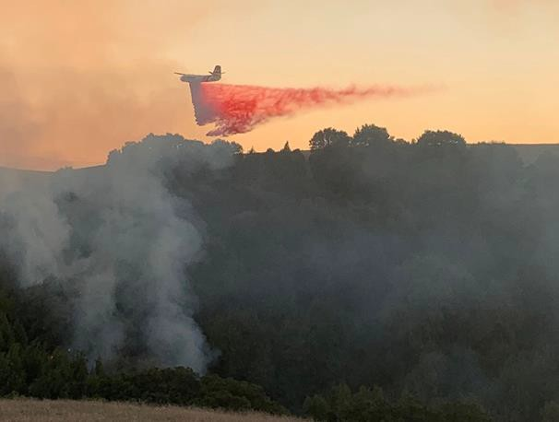
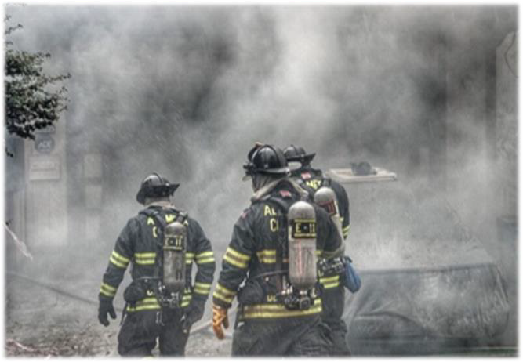
Measure X and Wildland Fire Disaster Responses
By addressing needed upgrades to or replacing fire stations, Measure X helps local firefighters effectively address ever - increasing fire danger in our unincorporated communities by assisting them to:
Better monitor the start of fires
Better control weeds, tall grass, and brush across the dozens of canyons and thousands of acres of our local open space.
6
Dedicated to Superior Service

Slide 7

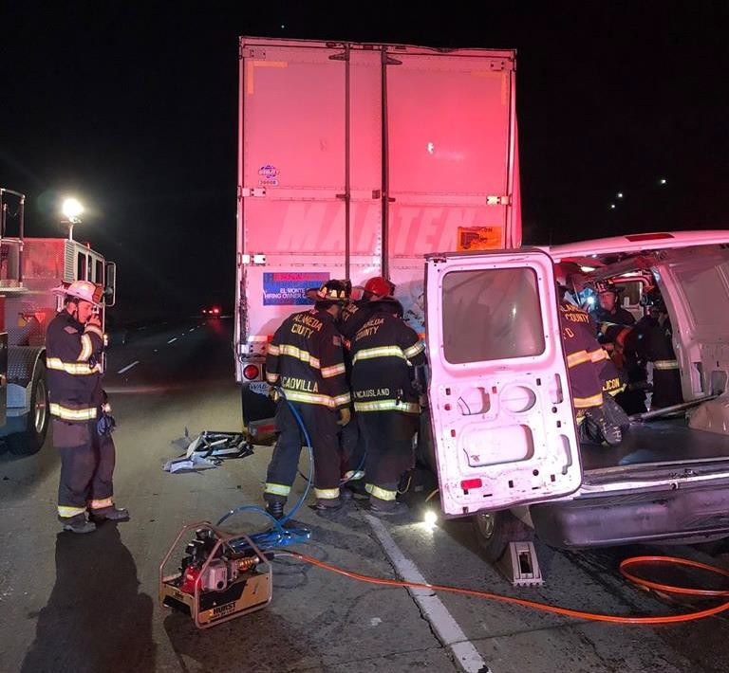
Measure X and Emergency Medical Response Times
Nearly 80% of our local 911 calls are for medical emergencies like heart attacks, strokes, and car accidents.
Measure X repairs/replaces fire stations so that we can reduce 911 emergency medical response times.
7
Dedicated to Superior Service

Slide 8
Is Measure X Fiscally Accountable?
Measure X fiscal accountability components include:
  Citizens Oversight
  Independent Audits
  Provides that no money can be spent on salaries, benefits, or
Pensions of Fire Department employees.
By law, all funds are required to be spent locally and none can be taken by Sacramento.
8

Slide 9
When is the election?
November 3, 2020
For more information, please visit our website at: www.acgov.org/fire/MeasureX
If you have specific questions, please contact the Fire District’s office at: (510) 632-3473.
9

